Slide 1

Cs 429:DATA MINING Lecture 9
Instructor:
Osama Ahmed Khan
osamaahmedkhan
Jul 4th, 2017

Slide 2
Statistical Modeling
Missing Values
Testing Data
Exclude from Probability calculations
Outlook
Temperature
Humidity
Windy
Play
?
cool
high
true
?
likelihood of yes = 3/9 × 3/9 × 3/9 × 9/14 = 0.0238
likelihood of no = 1/5 × 4/5 × 3/5 × 5/14 = 0.0343
Normalization
Probability of yes = 0.0238 / (0.0238 + 0.0343) = 41%
Probability of no = 0.0343 / (0.0238 + 0.0343) = 59%

Slide 3
Statistical Modeling
Missing Values
Training Data
Exclude from frequency and fraction counts

Slide 4
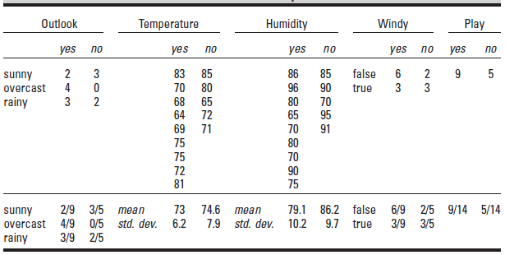
Statistical Modeling
Numeric Attributes
Assumption: Normal or Gaussian probability distribution
Weather Forecast Problem 2

Slide 5
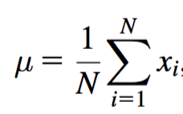
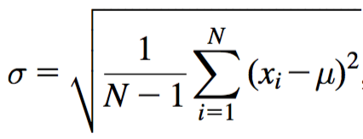
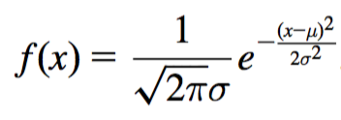
Statistical Modeling
Normal or Gaussian probability distribution
Mean
Standard Deviation
Probability Density Function
Probability of an attribute having exact value = 0
Probability that an attribute having a value lying within a certain range

Slide 6
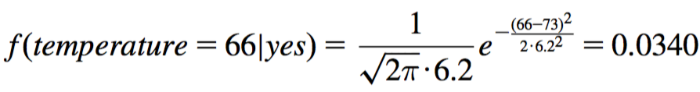
Statistical Modeling
Another new day:
Outlook
Temperature
Humidity
Windy
Play
sunny
66
90
true
?
likelihood of yes = 2/9 x 0.0340 × 0.0221 × 3/9 × 9/14 = 0.000036
likelihood of no = 3/5 × 0.0221 × 0.0381 × 3/5 x 5/14 = 0.000108
Normalization
Probability of yes = 0.000036 / (0.000036 + 0. 000108) = 25%
Probability of no = 0.000108 / (0.000036 + 0. 000108) = 75%

Slide 7
Statistical Modeling
Normal or Gaussian probability distribution
Probability values close to those of Categorical attributes
Makes it easier to apply Naïve Bayes on Numerical attributes
Missing Values
Testing Data
Exclude from Probability calculations
Training Data
Exclude from Mean and Standard Deviation calculations

